Slide 1


BASICS OF LINKED (BUILDING) DATA
4th Summer School of Linked Data in Architecture and Construction
@Ruhr Universität Bochum,
Jeroen Werbrouck
June 10th, 2024

Slide 2


Who am I?
Master of Engineering: Architecture – (UGent, 2013-2018)
Phd Research - (UGent/RWTH Aachen, 2019-2024)
H2020 BIM4Ren
Teaching assistant UGent
FWO grant “strategic basic research”

Slide 3
Presentation outline
The Digital Built Environment
The Evolution of the Web
Knowledge Graphs
Linked Building Data

Slide 4
THE DIGITAL BUILT ENVIRONMENT

Slide 5
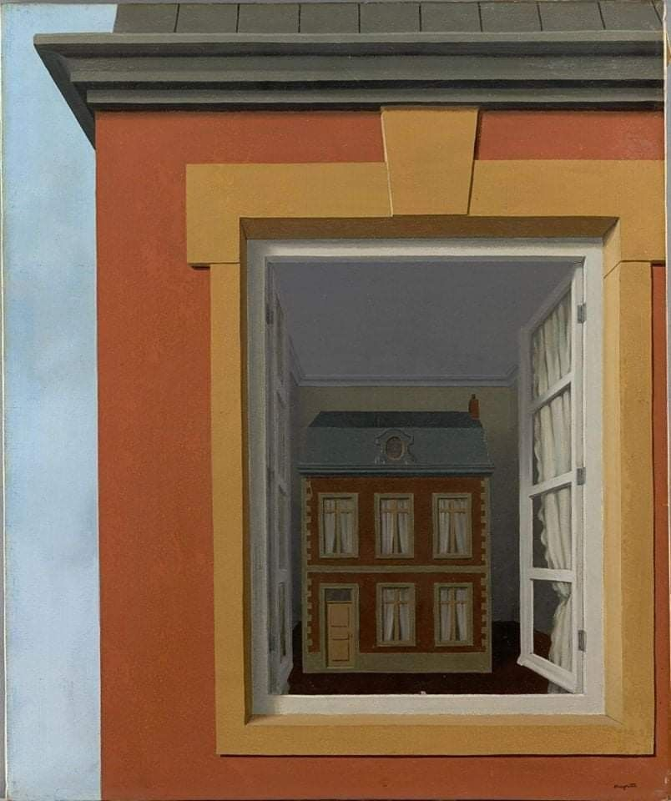
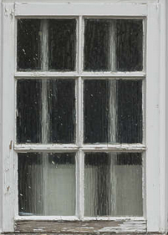
The digital built environment
Painting: In Praise of Dialectics (1936) R. Magritte

Slide 6




it’s a part of the building
envelope with poor insulation
It’s a ventilation opening
HVAC ENGINEER
ENERGY CONSULTANT
it allows natural light to flood into the space
The load of the mass above the window must be redirected
ARCHITECT
STRUCTURAL ENGINEER
The AEC Industries: Architecture, Engineering and Construction
Painting: In Praise of Dialectics (1936) R. Magritte
© icons by Vitaly Gorbachev

Slide 7
BIM?
BIM is the creation and use of coordinated, consistent, and computable information about a building project in design, in construction and in building operation and management.
BIM provides a digital representation of the physical and functional characteristics of a facility.
it’s a part of the building
envelope with poor insulation
It’s a ventilation opening
HVAC ENGINEER
ENERGY CONSULTANT
it allows natural light to flood into the space
The load of the mass above the window must be redirected
ARCHITECT
STRUCTURAL ENGINEER
The AEC Industries: Architecture, Engineering and Construction
Painting: In Praise of Dialectics (1936) R. Magritte
© icons by Vitaly Gorbachev

Slide 8
BIM?
A basic premise of BIM is collaboration
by different stakeholders
at different phases of the life cycle of a facility
to insert, extract, update or modify information in the BIM
to support and reflect the roles of that stakeholder.
it’s a part of the building
envelope with poor insulation
It’s a ventilation opening
HVAC ENGINEER
ENERGY CONSULTANT
it allows natural light to flood into the space
The load of the mass above the window must be redirected
ARCHITECT
STRUCTURAL ENGINEER
INTEROPERABILITY? = Need for standardisation!
The AEC Industries: Architecture, Engineering and Construction
Painting: In Praise of Dialectics (1936) R. Magritte
© icons by Vitaly Gorbachev

Slide 9
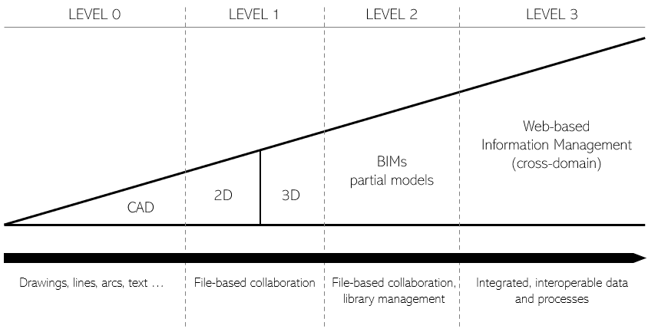
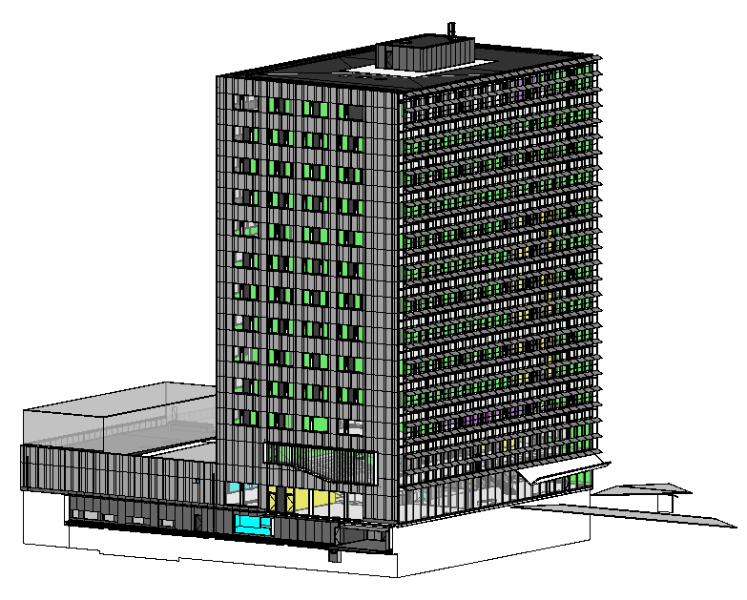
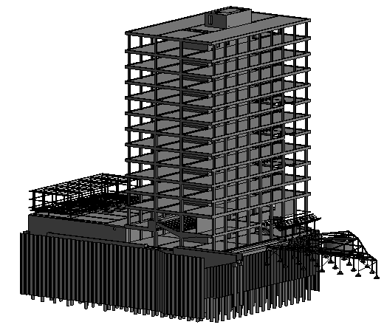

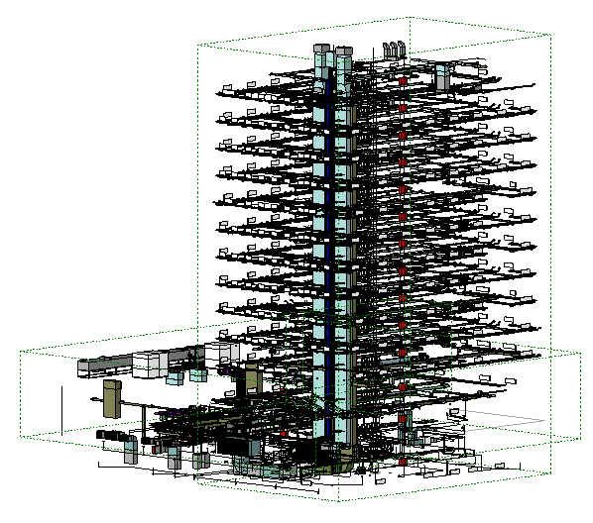
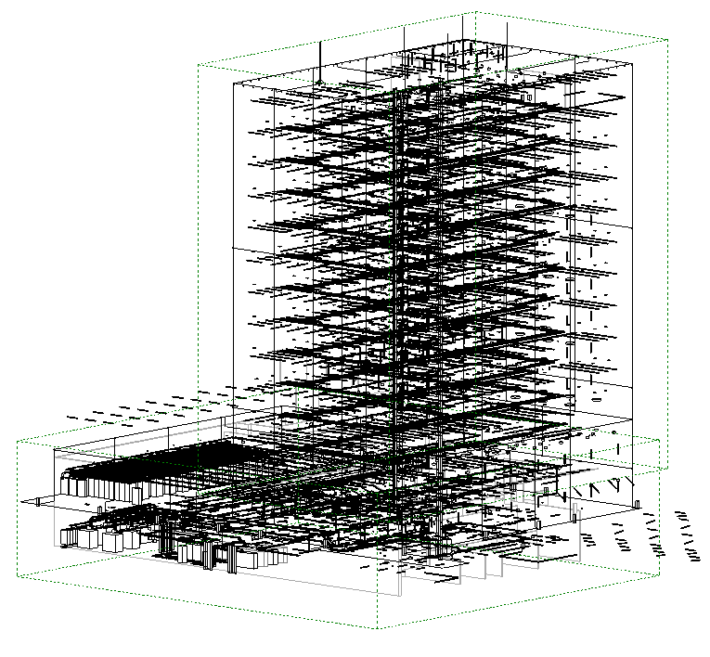
Collaboration in AEC: CDEs
CDE
Building Information Model (“BIM”)

Slide 10
Standardisation in AEC
Industry Foundation Classes (IFC)
BIM Collaboration Format (BCF)
green building XML (gbXML)
…

Slide 11
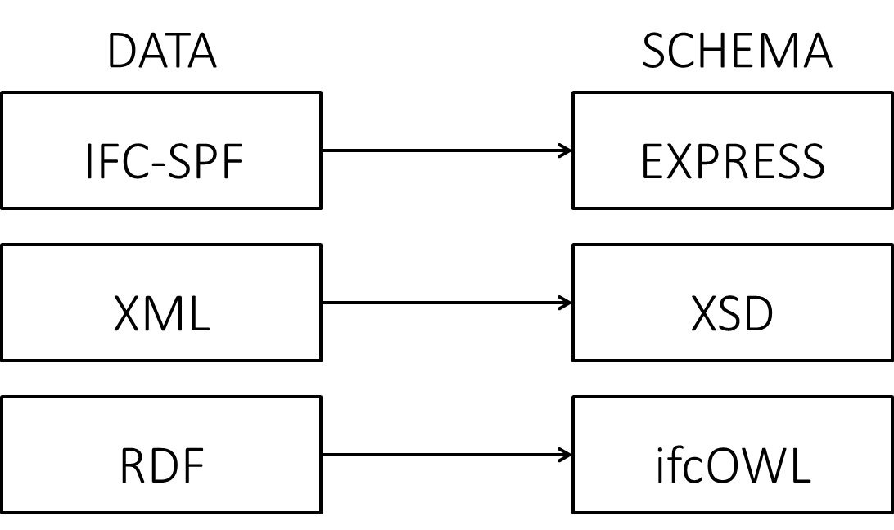
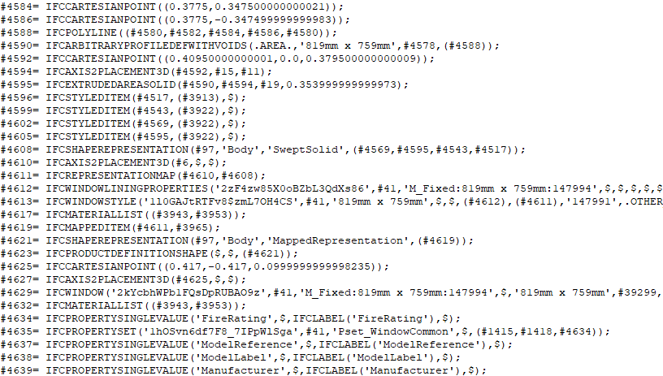
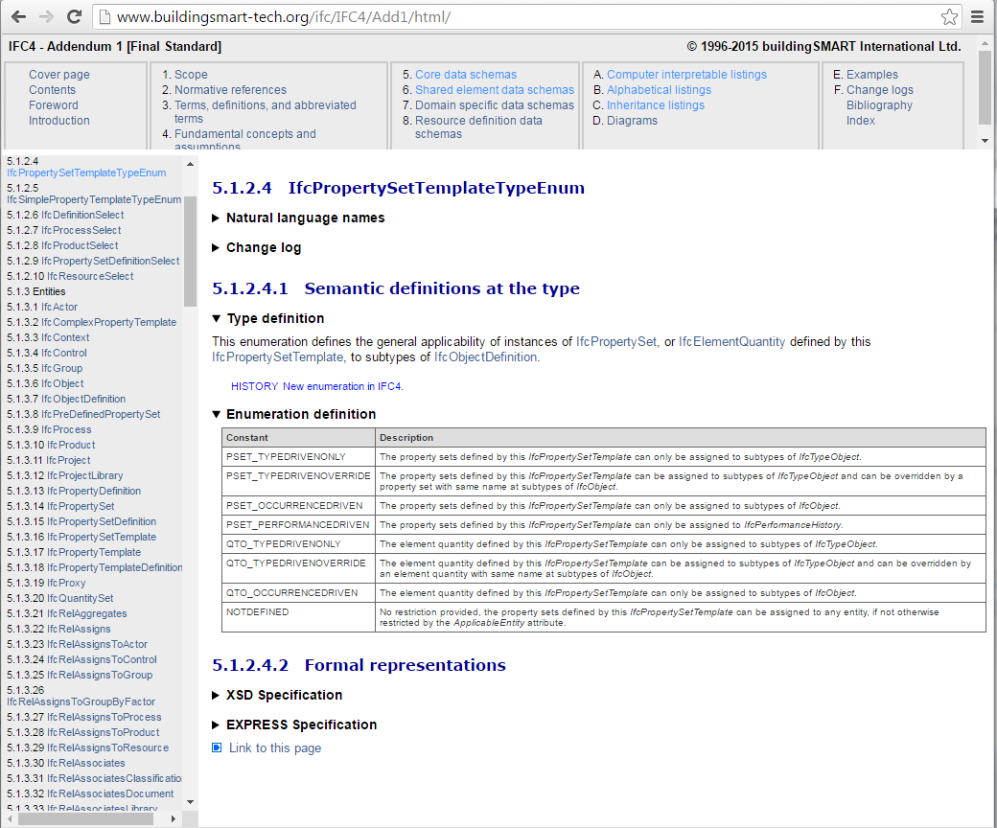
Industry Foundation Classes
Terminology & structure
The actual data

Slide 12
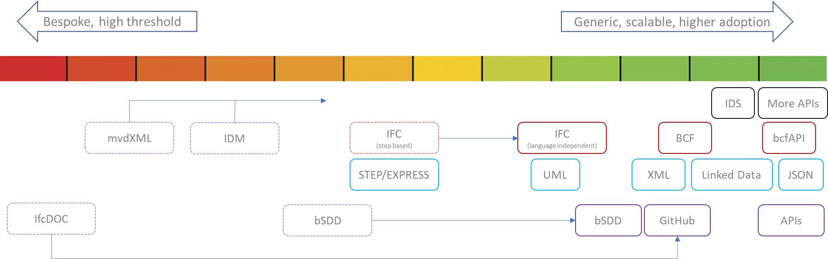
IFC Technical Roadmap – move to the web
https://www.buildingsmart.org/about/technical-roadmap/

Slide 13
it’s a part of the building
envelope with poor insulation
It’s a ventilation opening
HVAC ENGINEER
ENERGY CONSULTANT
it allows natural light to flood into the space
The load of the mass above the window must be redirected
ARCHITECT
STRUCTURAL ENGINEER
The AEC Industries: Architecture, Engineering and Construction
Painting: In Praise of Dialectics (1936) R. Magritte
© icons by Vitaly Gorbachev

Slide 14

it’s an asset that requires cleaning and painting
FACILITY MANAGER
it’s a part of the building
envelope with poor insulation
It’s a ventilation opening
HVAC ENGINEER
ENERGY CONSULTANT
it allows natural light to flood into the space
The load of the mass above the window must be redirected
ARCHITECT
STRUCTURAL ENGINEER
The AECO Industries: Architecture, Engineering, Construction and Operations
Painting: In Praise of Dialectics (1936) R. Magritte
© icons by Vitaly Gorbachev

Slide 15




it’s a fire escape
it’s an asset that requires cleaning and painting
It’s just a painting
FIRE SAFETY ENGINEER
FACILITY MANAGER
PAINTER
it’s a part of the building
envelope with poor insulation
It’s a ventilation opening
HVAC ENGINEER
ENERGY CONSULTANT
it allows natural light to flood into the space
The load of the mass above the window must be redirected
ARCHITECT
STRUCTURAL ENGINEER
it’s a surface with low
sound absorption!!!
MY curtains must close automatically when it’s dark
OWNER
ACOUSTIC CONSULTANT
Painting: In Praise of Dialectics (1936) R. Magritte
© icons by Vitaly Gorbachev

Slide 16
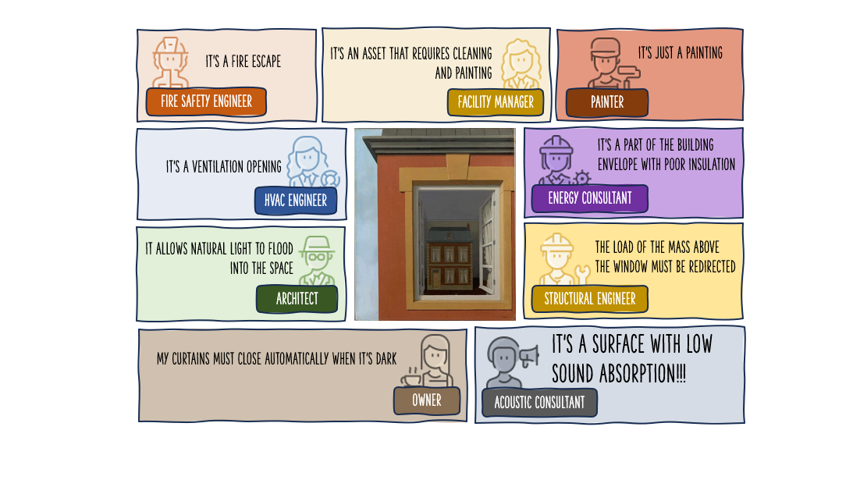
Painting: In Praise of Dialectics (1936) R. Magritte
© icons by Vitaly Gorbachev

Slide 17





this is a site with geothermY potential
The nearest railway station
is 3km away.
SOIL MAPS API
INFRASTRUCTURE API
Does this building comply
to accessibility rules?
GOVERNMENT API
There’s a storm today. Don’t go to the building site.
This is an archaeologically interesting location.
we MUST DIG OUT the dino’s BEFORE STARTING THE WORK!
WEATHER API
ARCAHEOLOGY API
The AECOOHHGGQSDFXYZ🍕 Industry?
Painting: In Praise of Dialectics (1936) R. Magritte
© icons by Vitaly Gorbachev

Slide 18
The AECO(OHHGGQSDFXYZ🍕) Industry?
Ever-increasing need for domain-independent information reuse
Architecture
Engineering
Construction
Operations
Owner
History & Heritage
Geospatial
Government
User Preferences
…

Slide 19
this is a site with geothermY potential
The nearest railway station
is 3km away.
SOIL MAPS API
INFRASTRUCTURE API
Does this building comply
to accessibility rules?
GOVERNMENT API
There’s a storm today. Don’t go to the building site.
This is an archaeologically interesting location.
we MUST DIG OUT the dino’s BEFORE STARTING THE WORK!
WEATHER API
ARCAHEOLOGY API
ONE SINGLE, CENTRALISED PLATFORM?
Painting: In Praise of Dialectics (1936) R. Magritte
© icons by Vitaly Gorbachev

Slide 20
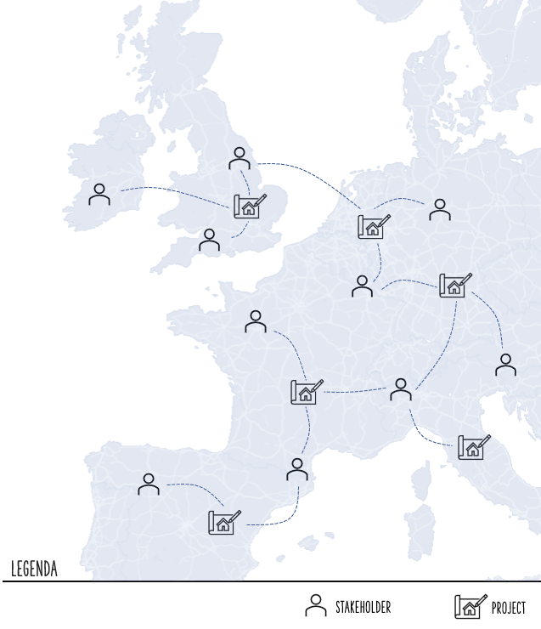
Data Federation
Every building is the sum of the
(domain-specific) contributions
of multiple stakeholders
Direct stakeholders: architect, engineer, owner, …
Indirect stakeholders: government, infrastructure, …
LEGENDA

Slide 21
Data Federation
Every stakeholder
takes part in multiple projects
LEGENDA

Slide 22
Web-based Building Data

Slide 23
THE EVOLUTION OF THE WEB

Slide 24

The World Wide Web
Distributed by design
Decentralized
For everyone
Graph of links between things
Dynamic
Open and closed

Slide 25
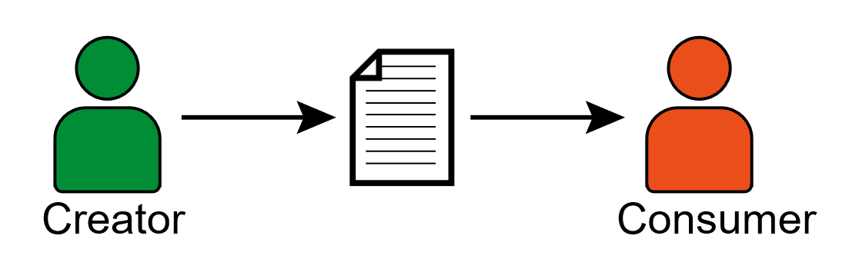
Web 1.0
Read-only
Web of documents

Slide 26
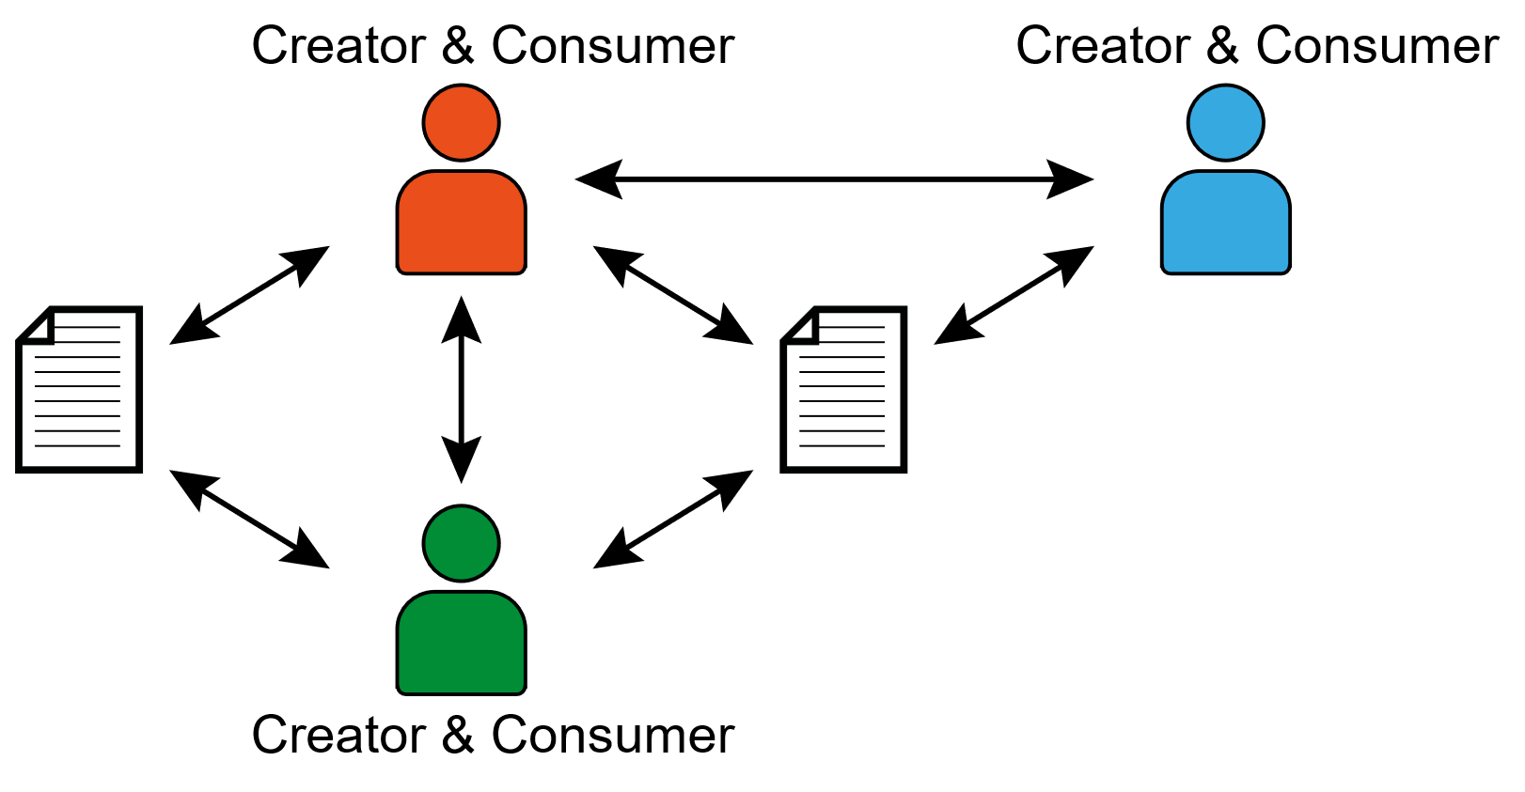
Web 2.0
Read-write-publish
Web of people

Slide 27
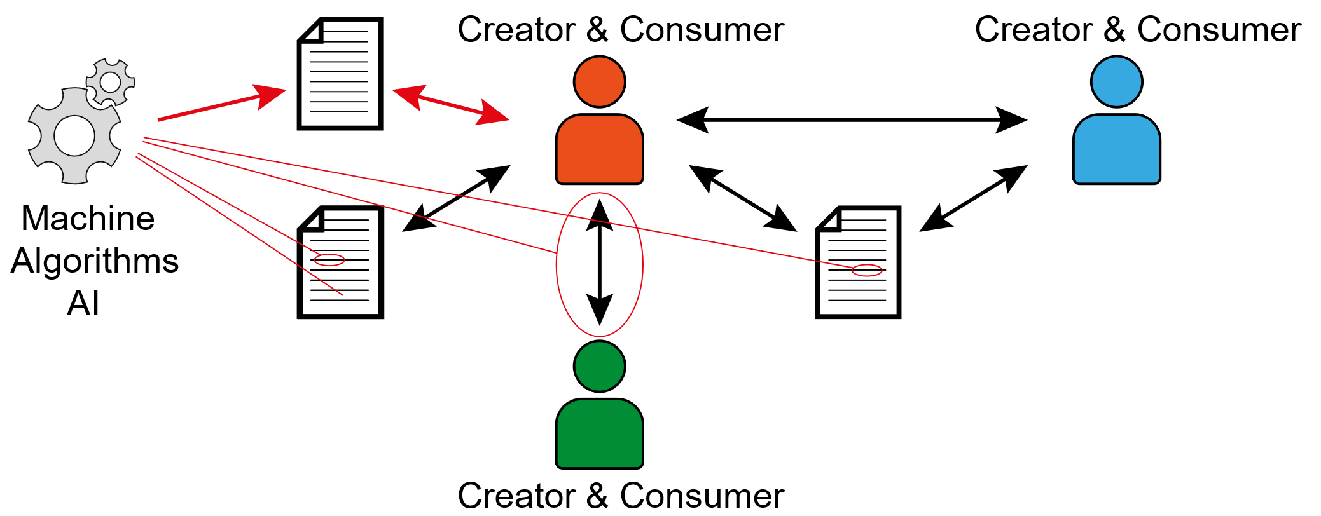
Web 3.0
Read-write-execute

Slide 28
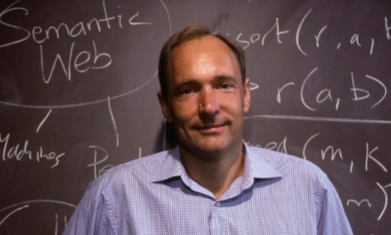
Information on the Web
People can parse the web of documents and extract information from them to come to insights.
We need to help machines to understand the web, so machines can help us understand things.
If machines have access to the data about things, they can do a better job while processing documents.

Slide 29
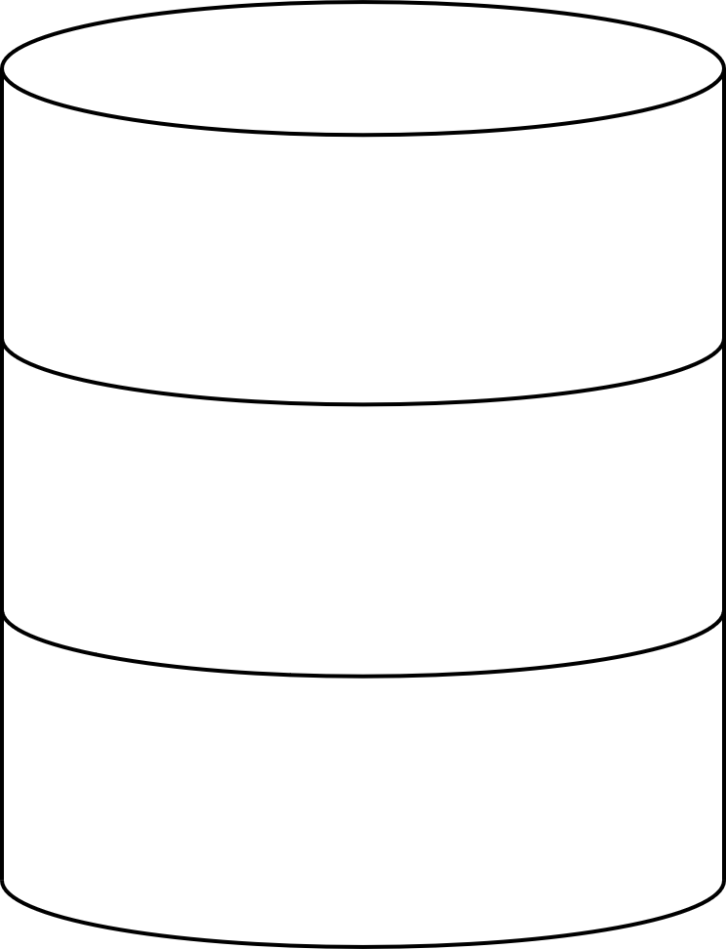
Web services: Fetching Data (GET)
REST API
2a. Retrieve 5 most recent wall posts
1. Show me this webpage
4. there you go
3. Build webpage with
most recent content
2b. store image

Slide 30
Web services: Posting Data (POST)
REST API
2. Store text, title, etc.
1. Create this new wall post
3. Done!
2b. Retrieve associated images

Slide 31
Content Negotiation
REST API
Person X requested wall posts
Give me the wall posts in JSON
REST API
Retrieve 5 most recent wall posts
there you go
Retrieve associated images

Slide 32
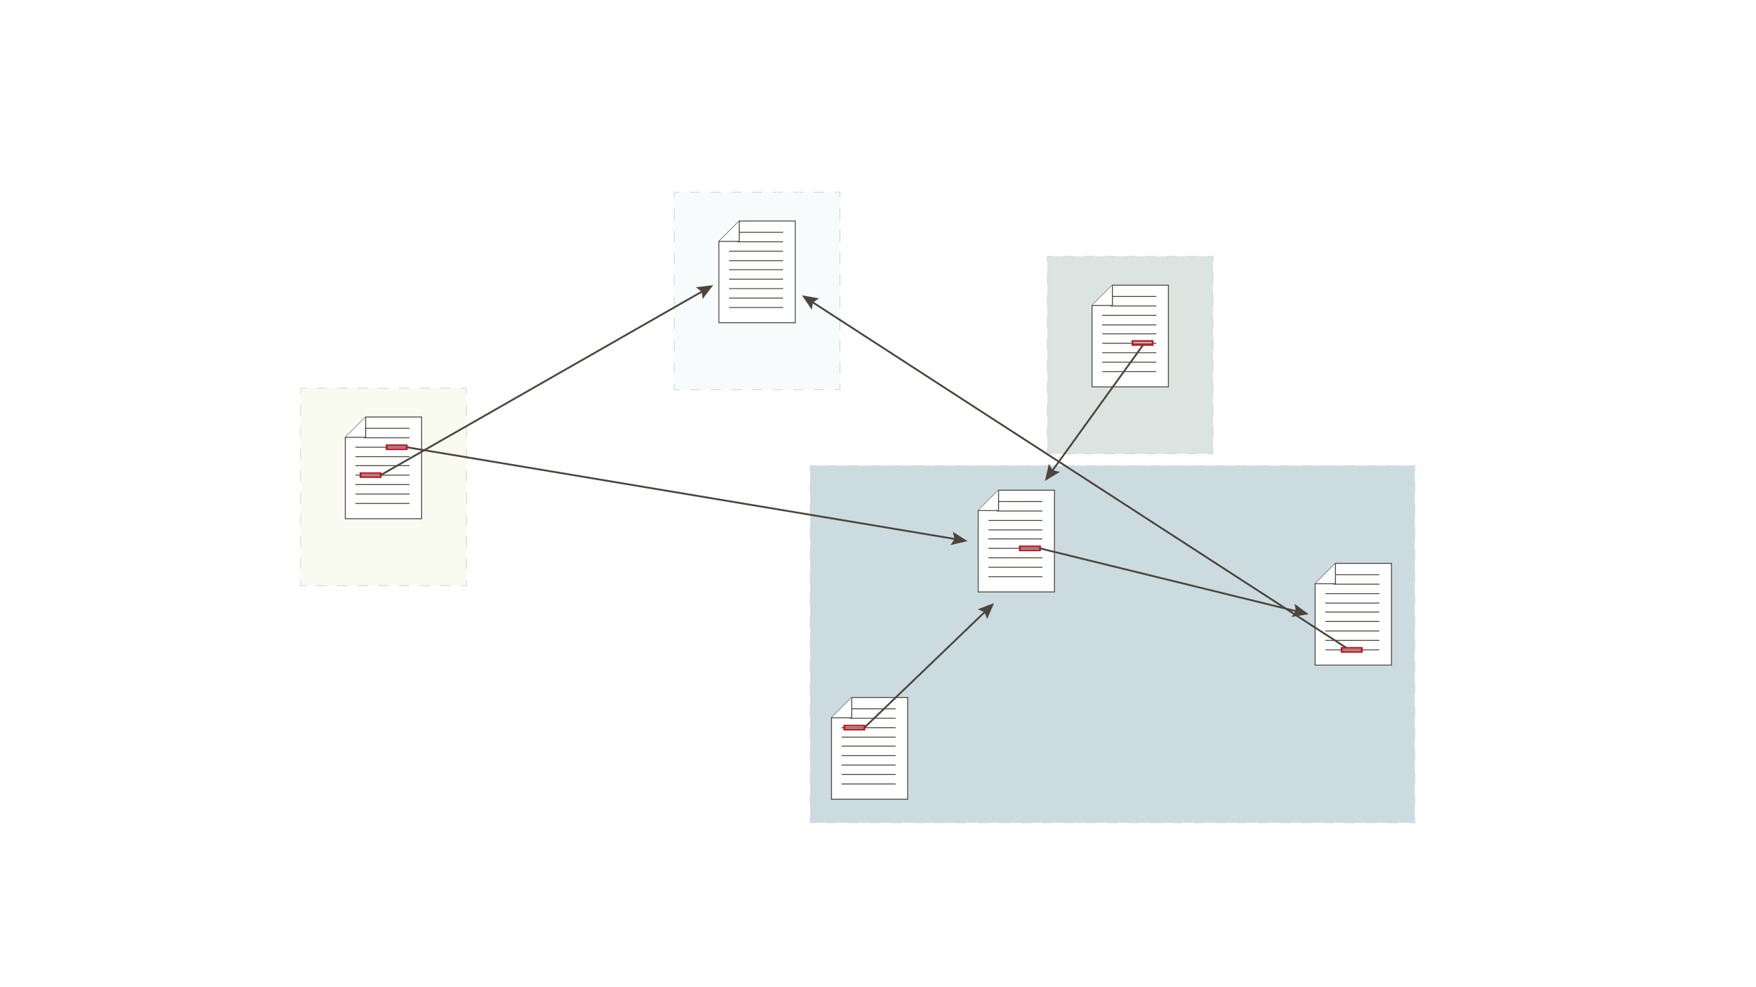
Web of documents

Slide 33

Web of Data

Slide 34
The Semantic Web is needed: a Web of Data
“The Semantic Web is an extension of the current web in which information is given well-defined meaning, better enabling computers and people to work in cooperation.” [Tim Berners-Lee et al. 2001.]
Specific goals:
Build a description language with standard semantics
Make semantics machine-processable and understandable
Incorporate logical infrastructure to reason about resources
W3C Specificaions: Resource Description Framework (RDF) and SPARQL

Slide 35
KNOWLEDGE GRAPHS

Slide 36
Graph Theory and Graph Thinking
Graphs as mathematical structures used to model pairwise relations between objects
Graph theory was pioneered by Euler in the 18th century, and has been actively researched and improved by mathematicians, sociologists, anthropologists, etc.
only in the past few years have graph theory and graph thinking been applied to information management
Possible to leverage complex and dynamic relationships in highly connected data

Slide 37
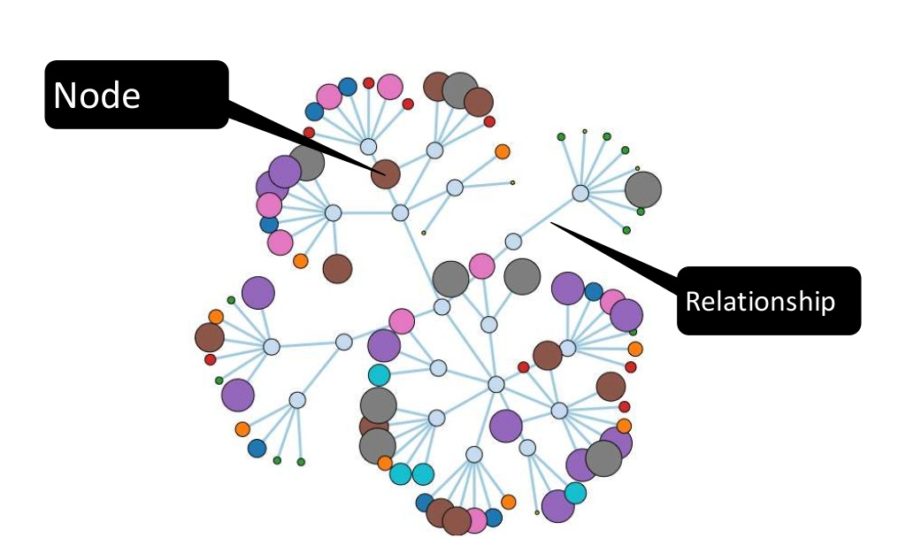
What is a Ggraph?
vertices / nodes and edges / relationships
General-purpose, expressive structure allows us to model all kinds of scenarios
Focus on the connections and links: a lot more than in relational databases

Slide 38
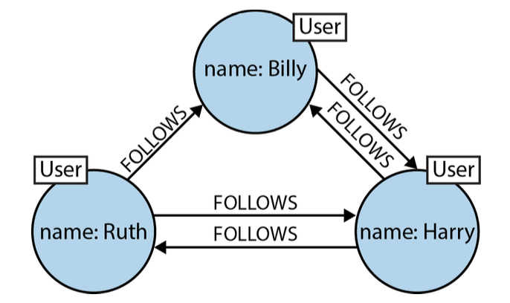
Graph Data Example: a social network
Any social network’s data is easily represented as a graph
Each node is labeled User, indicating its role in the network. These nodes are then connected with relationships, which help further establish the semantic context: who follows who?

Slide 39
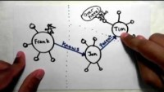

Slide 40
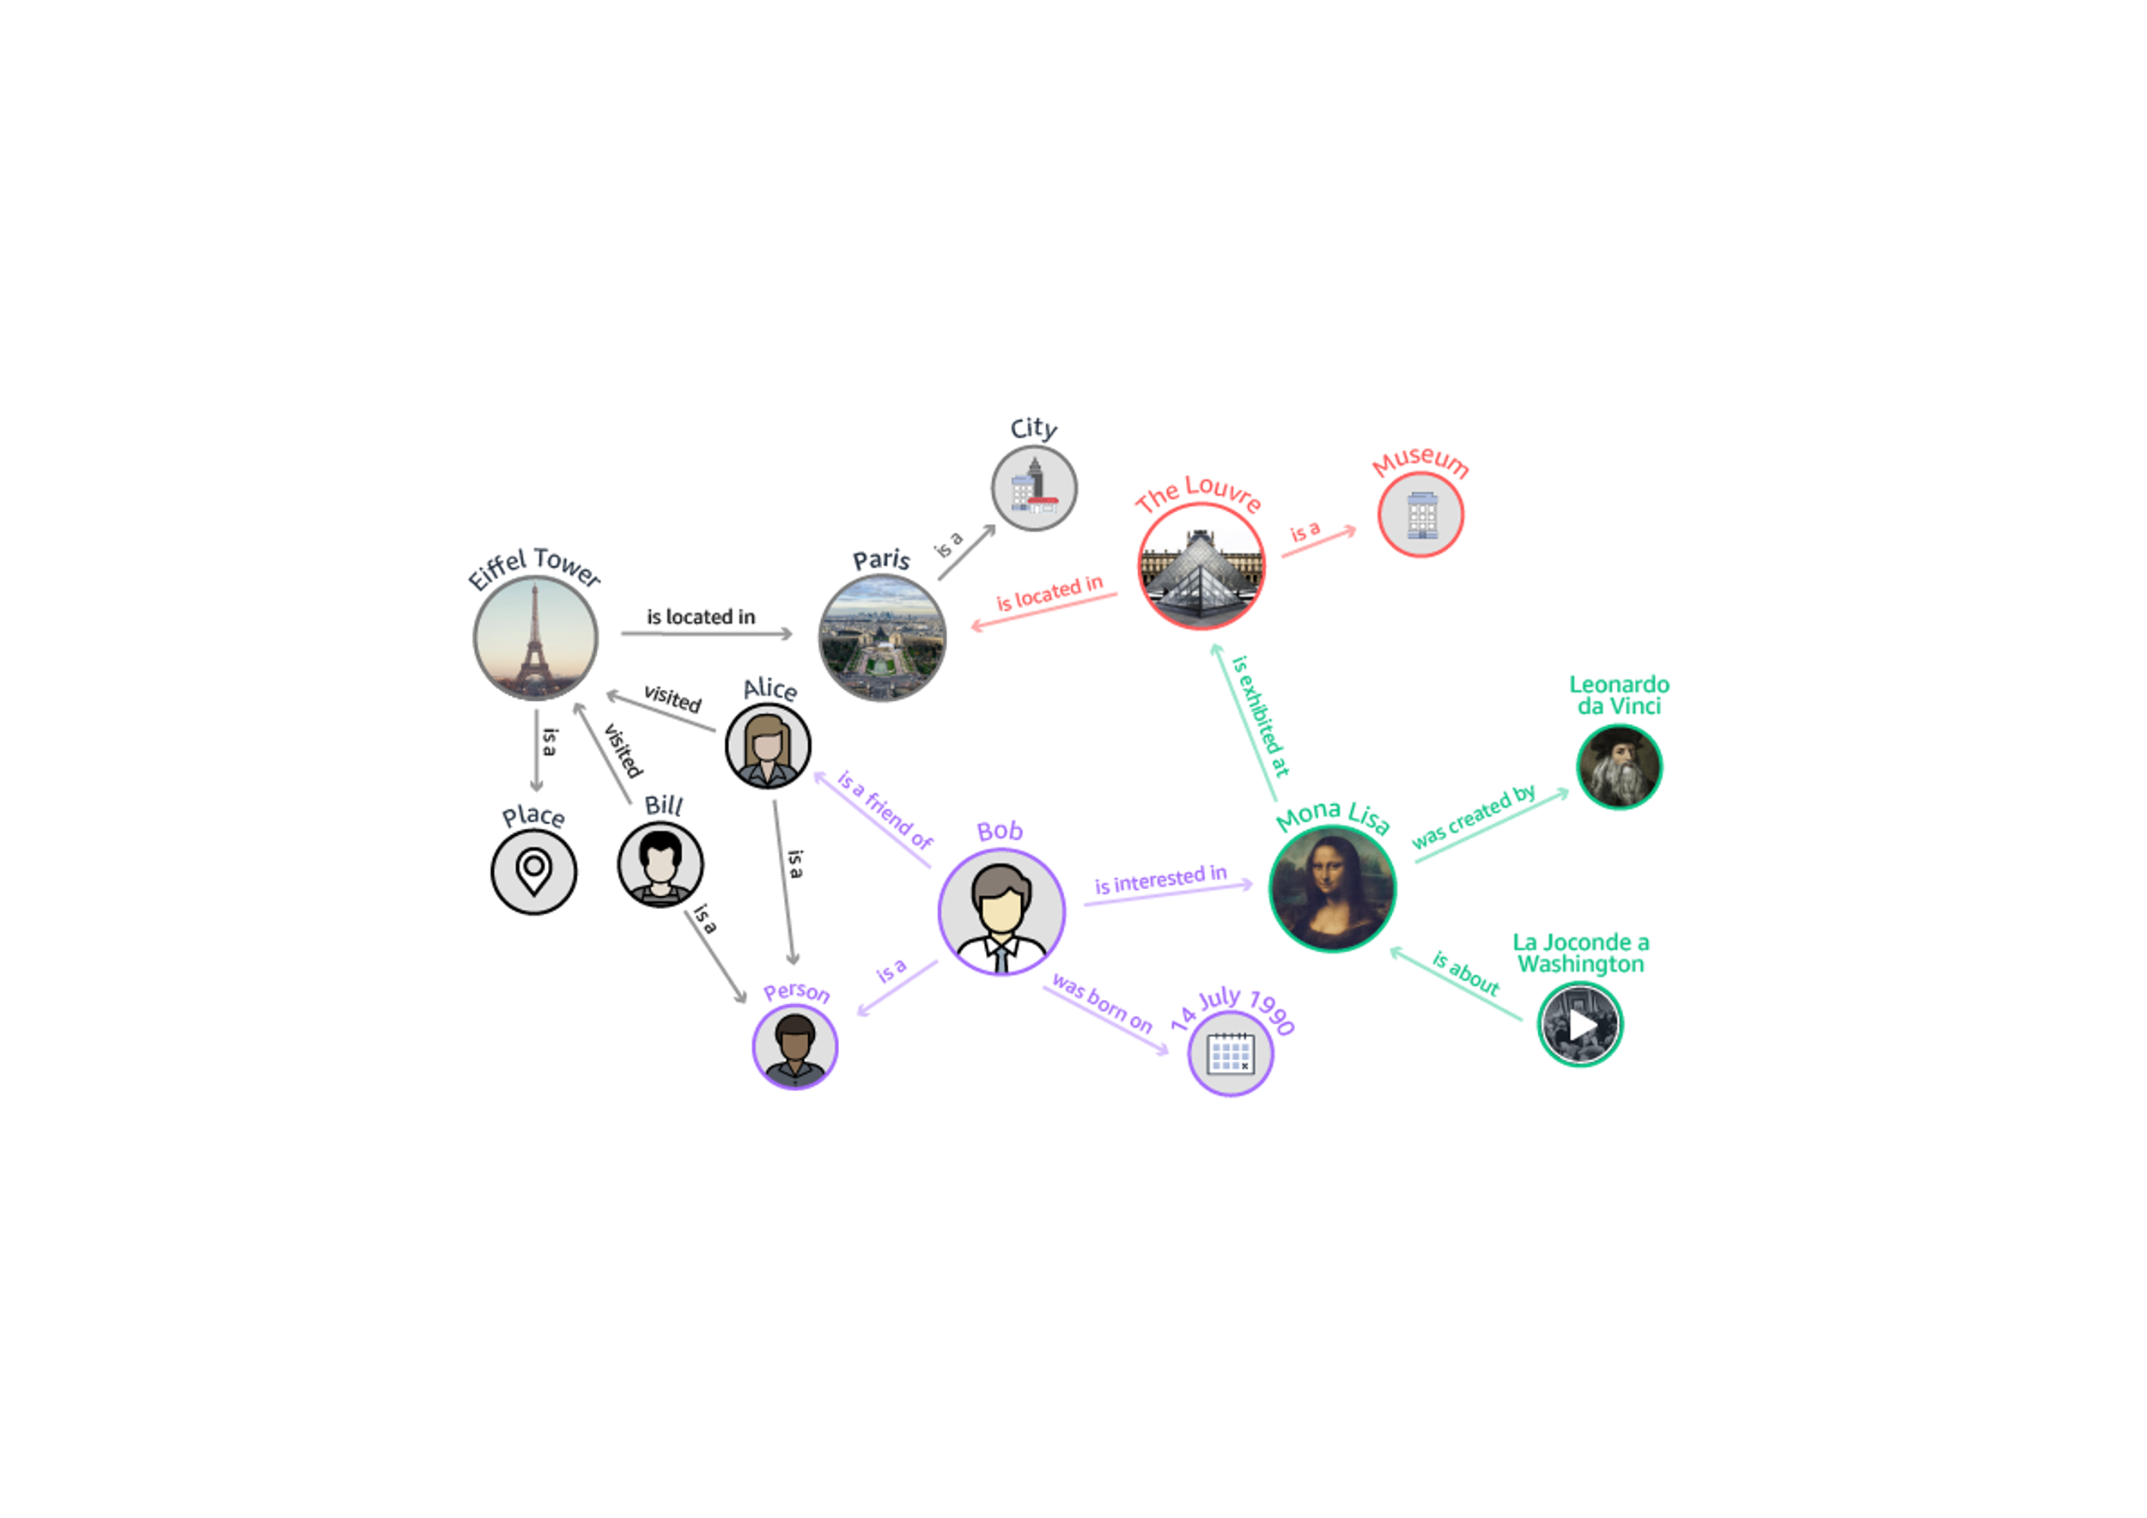
Knowledge Graphs
https://aws.amazon.com/neptune/

Slide 41
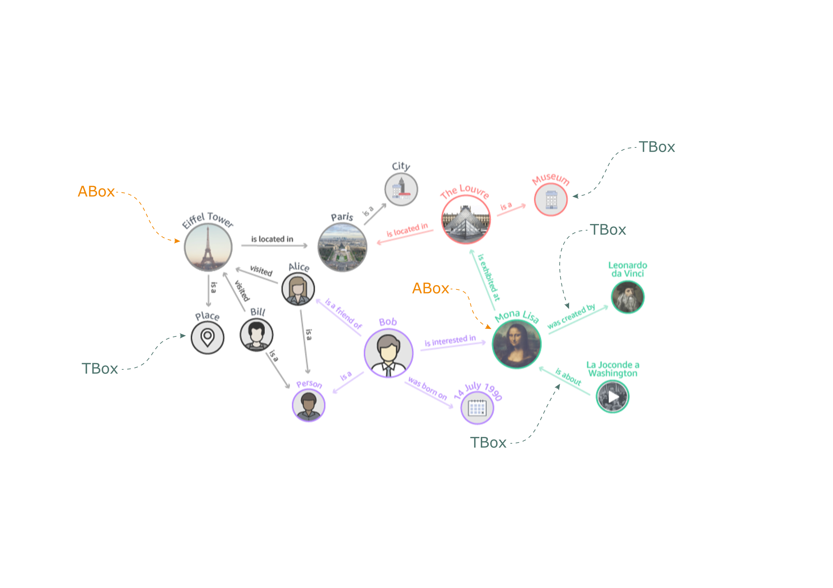
Knowledge Graphs
https://aws.amazon.com/neptune/

Slide 42
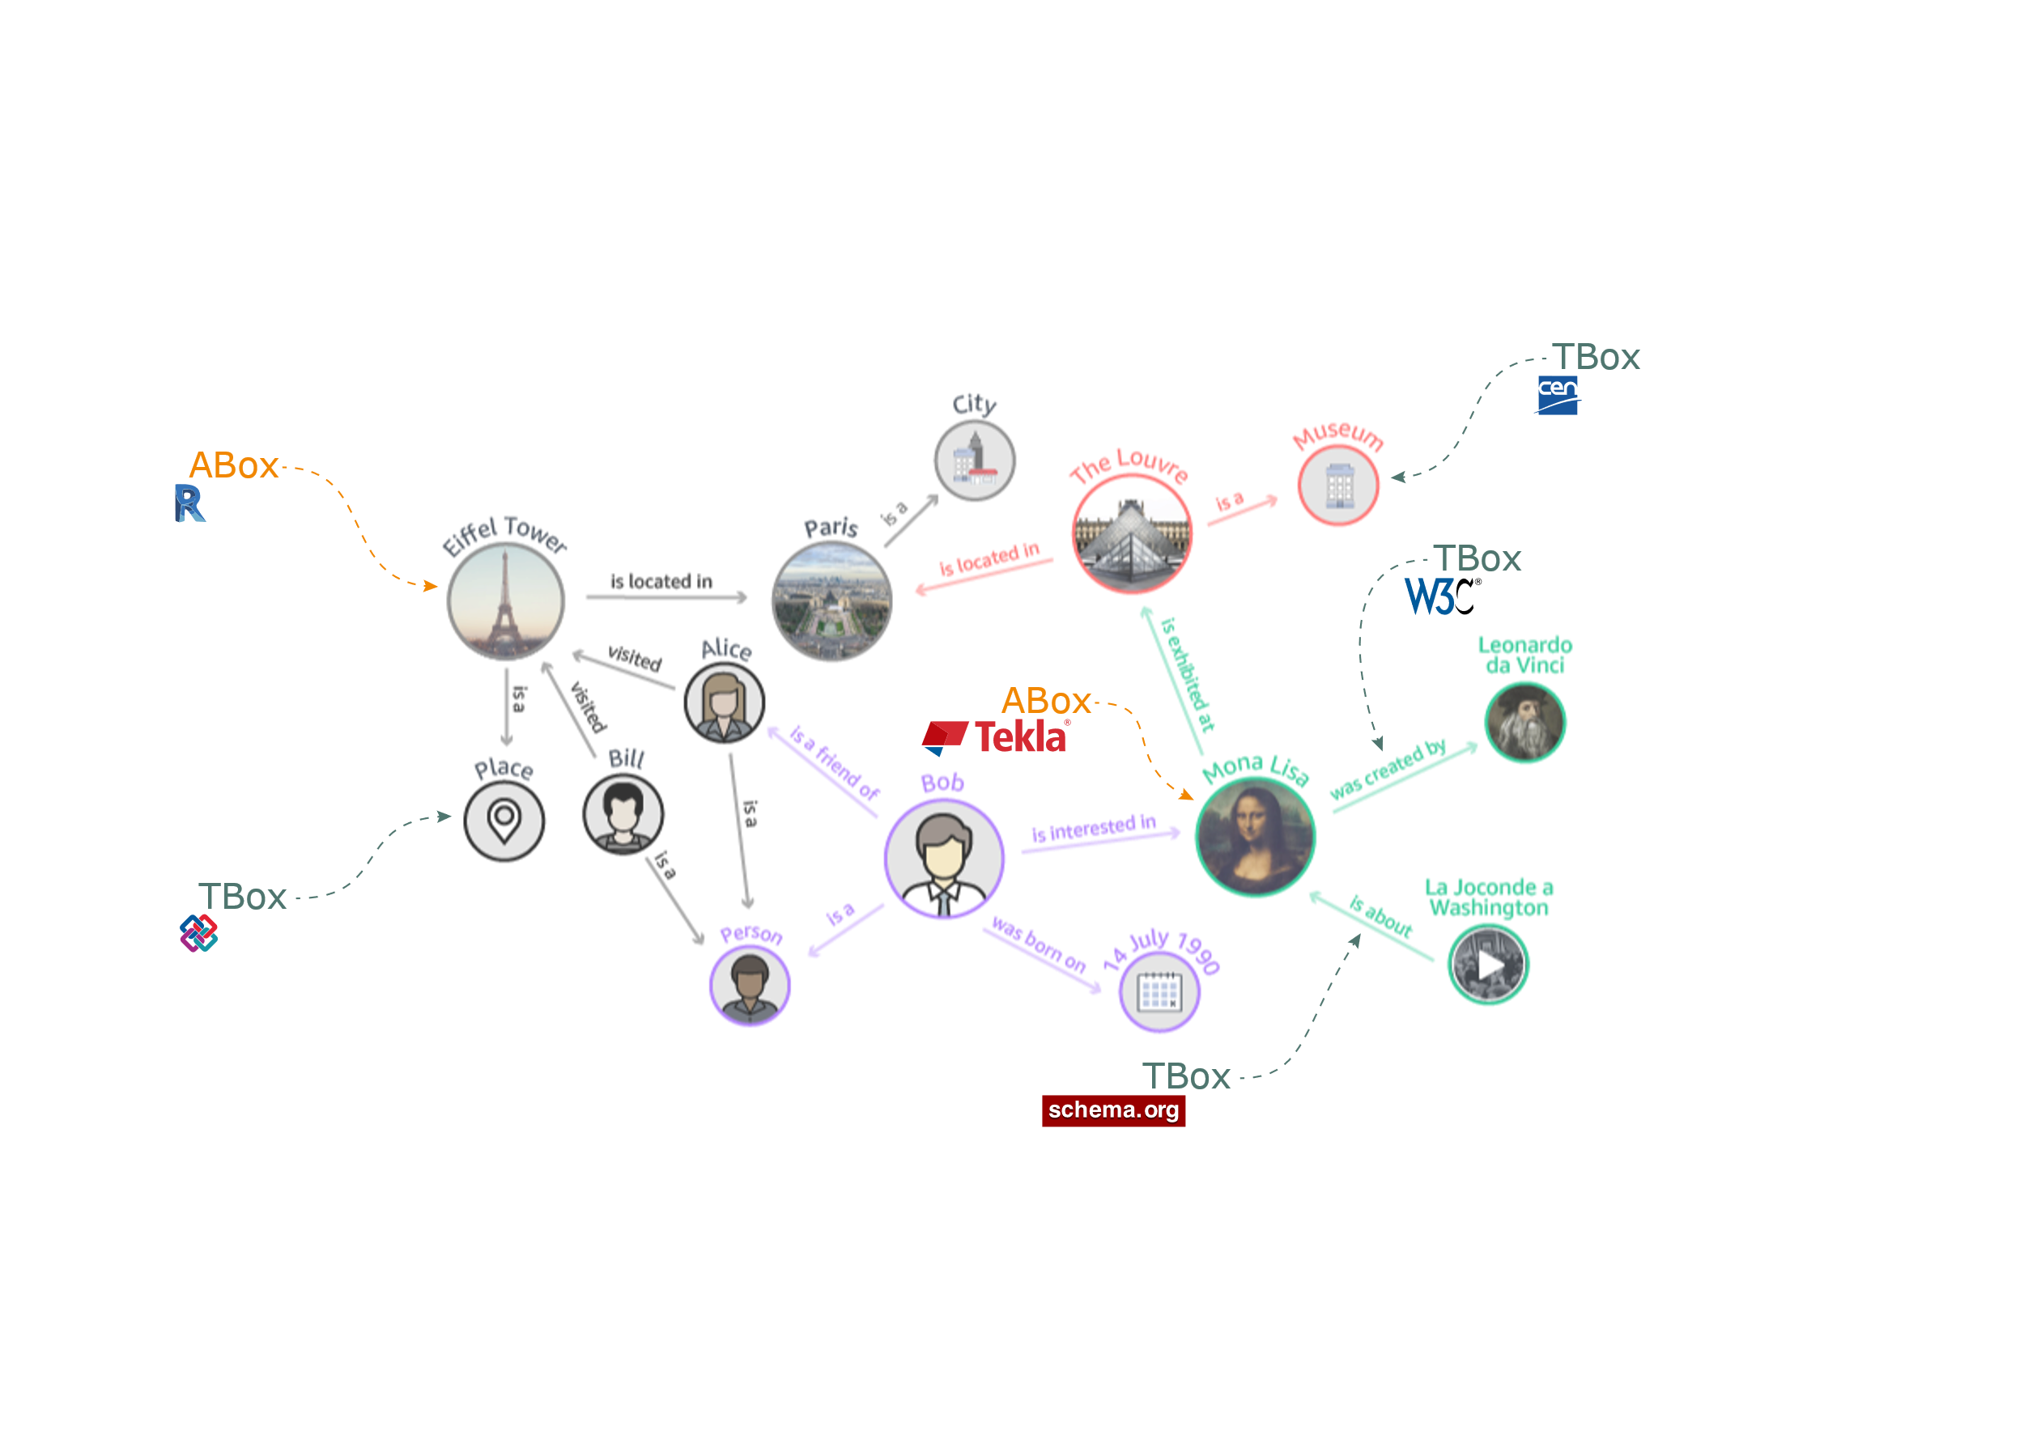
A knowledge graph
https://aws.amazon.com/neptune/

Slide 43
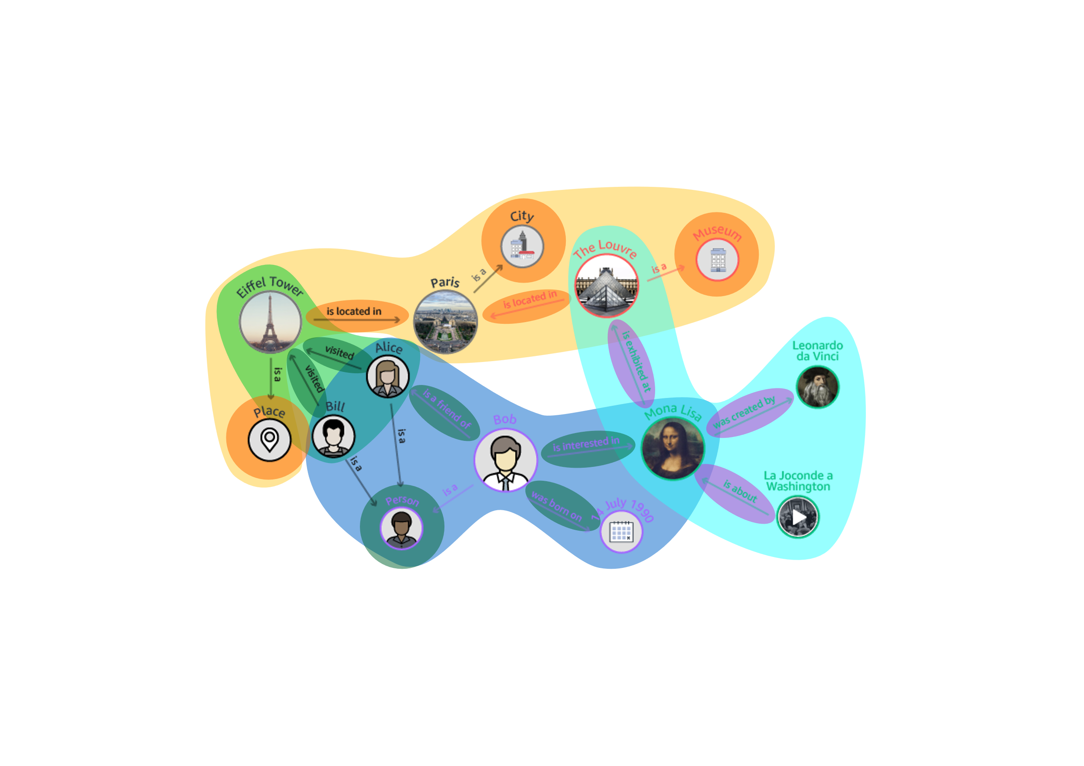
Federated Knowledge Graphs
https://aws.amazon.com/neptune/

Slide 44
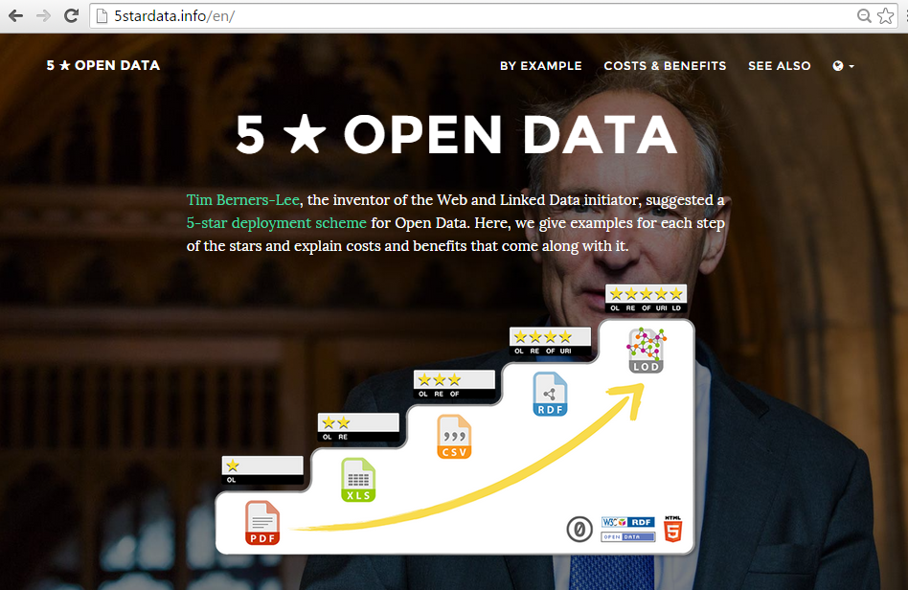
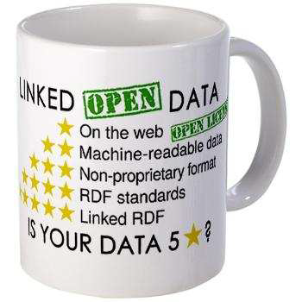
linked open data

Slide 45
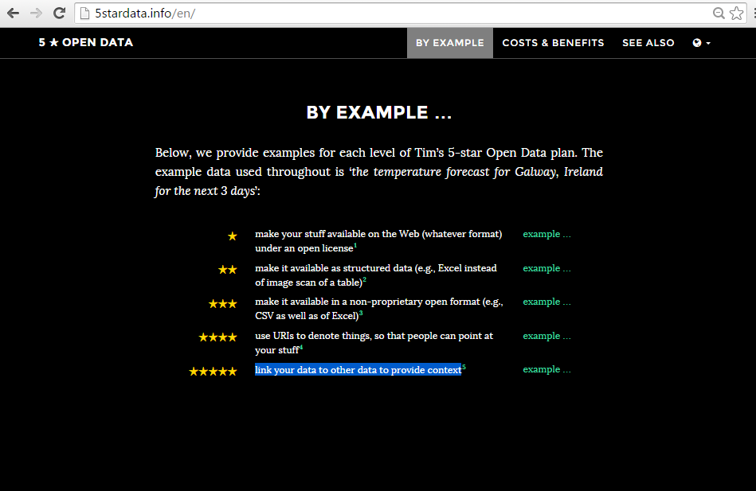

Slide 46
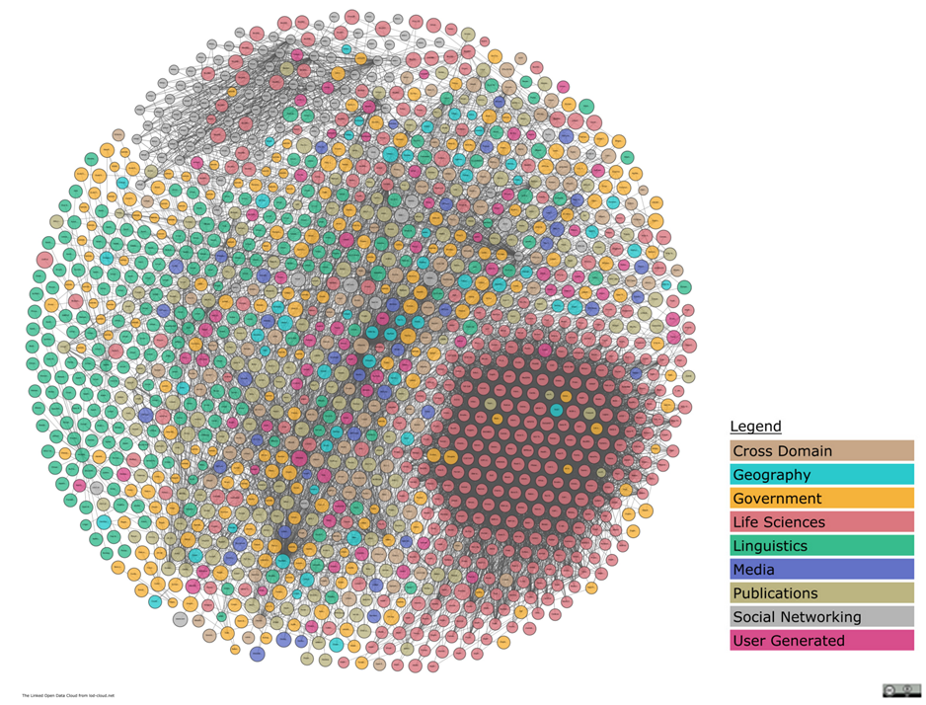
Linked Open Data Cloud
https://lod-cloud.net/

Slide 47
Knowledge Graphs: RDF
“Triples” are basic sentences of the form “subject – predicate – object”
Everything you can talk about is a “resource”
subject
predicate
object
JEROEN
GIVES
PRESENTATION
JEROEN
LIVES IN
GHENT
PRESENTATION
TAKES PLACE IN
BOCHUM
GHENT
IS A
CITY
BOCHUM
IS A
CITY

Slide 48
Knowledge Graphs: RDF
Multiple (overlapping) triples form a “directed graph”
JEROEN
GIVES
PRESENTATION1
TAKES PLACE IN
BOCHUM
IS A
LIVES IN
GHENT
IS A
CITY
Instance
Class

Slide 49
Knowledge Graphs: RDF
Uniform Resource Identifiers (URIs)
Literals
Literal
URI
http://purl.org/dc/terms/title
“LDAC_introduction.pptx”
https://jeroen.werbrouck.me/profile/card#me
GIVES
https://jeroen.werbrouck.me/presentations/LDACpresentation
https://dbpedia.org/page/Presentation
http://www.w3.org/1999/02/22-rdf-syntax-ns#type
http://purl.org/oslo/ns/localgov#residence
https://dbpedia.org/page/ghent
https://dbpedia.org/page/City
http://www.w3.org/1999/02/22-rdf-syntax-ns#type

Slide 50
Knowledge Graphs: RDF
Uniform Resource Identifiers (URIs)
dct:title
“LDAC_introduction.pptx”
https://jeroen.werbrouck.me/profile/card#me
swpo:givesPresentations
https://jeroen.werbrouck.me/presentations/LDACpresentation
https://dbpedia.org/page/Presentation
schema:location
rdf:type
oslo:residence
https://dbpedia.org/page/Ghent
PREFIXES:
@prefix rdf: <http://www.w3.org/1999/02/22-rdf-syntax-ns#>
@prefix dct: <http://purl.org/dc/terms/>
@prefix oslo: <http://purl.org/oslo/ns/localgov#>
@prefix schema: <http://schema.org/>
@prefix swpo: <http://sw-portal.deri.org/ontologies/swportal#>
https://dbpedia.org/page/City
rdf:type
(alternative: “a” )

Slide 51
Knowledge Graphs: RDF
Uniform Resource Locators (URLs)
:me a foaf:Person ;
foaf:firstName “Jeroen” ;
foaf:lastName “Werbrouck” .
…
leads to
dct:title
“The Web as a Common …”
https://jeroen.werbrouck.me/profile/card#me
swpo:givesPresentations
https://jeroen.werbrouck.me/presentations/phdpresentation
https://dbpedia.org/page/Presentation
schema:location
rdf:type
oslo:residence
https://dbpedia.org/page/Ghent
https://dbpedia.org/page/City
rdf:type

Slide 52
Notation: Turtle (.ttl)
@prefix bot: <https://w3id.org/bot#> .
@prefix : <http://mydata.org/project1#> .
:wall1 a bot:Element ,
beo:Wall .
:space1 a bot:Space ;
bot:adjacentElement :wall1 .
Machine- and human-readable syntax
Prefixes / Namespaces
Punctuation
. ends a triple
; triple has the same subject
, triple has the same subject / predicate
Full URLs are wrapped: <url>

Slide 53
Querying: SPARQL
SPARQL Protocol And RDF Query Language
Very expressive
SELECT (output = table)
CONSTRUCT (output = RDF graph)
ASK (output = Boolean)
PREFIX bot: bot: <https://w3id.org/bot#>
SELECT ?sp ?w WHERE {
?sp a bot:Space ;
bot:adjacentElement ?w .
}

Slide 54
INTERACTIVE: make a graph about yourself with some
instances (e.g. you, friends, family, …)
relationships (e.g. “hasFriend”, “hasHobby”, “hasAge”, …)
classes (e.g. “Friend”, “Hobby”)
Literals (e.g. a number (age), a string (name), …)
! You can use example URI’s as prefixes
(they don’t need to resolve to an actual Web-address to be correct syntax)
Playground: https://madsholten.github.io/sparql-visualizer/

Slide 55
Linked Building Data

Slide 56
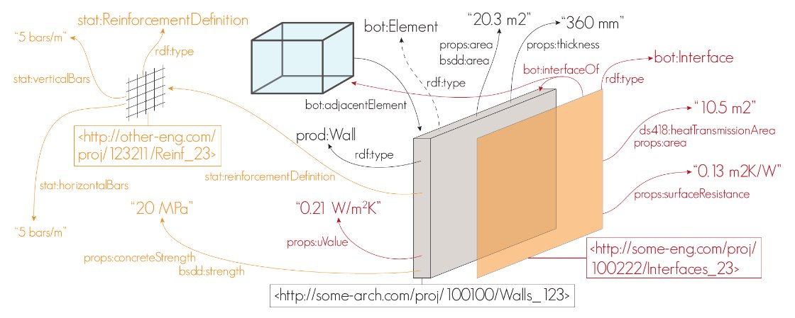
Knowledge graphs in AECO
Image source: © Mads Holten Rasmussen, bSI London 2017

Slide 57
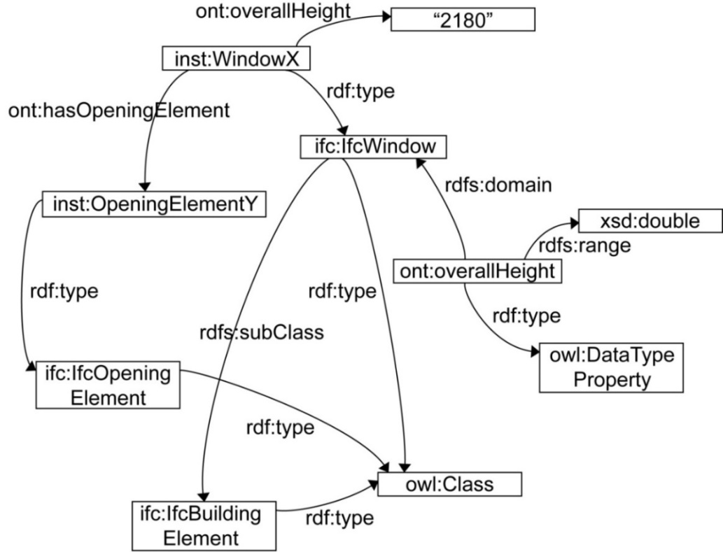
ifcOWL
Certified standard, RDF equivalent IFC-SPF
http://www.buildingsmart-tech.org/ifcOWL/IFC4_ADD2#
Pauwels, P., & Terkaj, W. (2016). EXPRESS to OWL for construction industry: Towards a recommendable and usable ifcOWL ontology. Automation in construction, 63, 100-133.

Slide 58
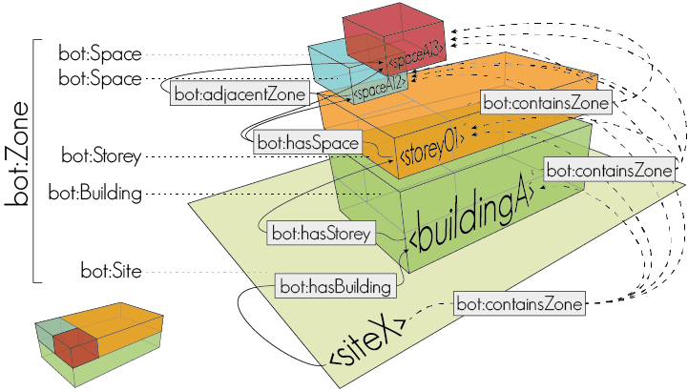
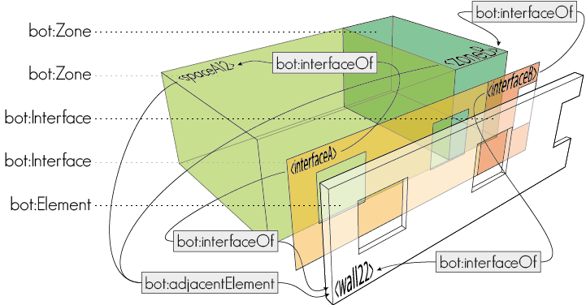
Building Topology Ontology
https://w3id.org/bot#

Slide 59
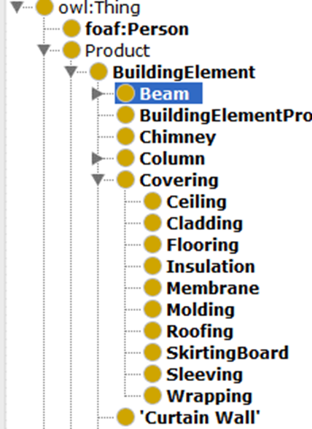
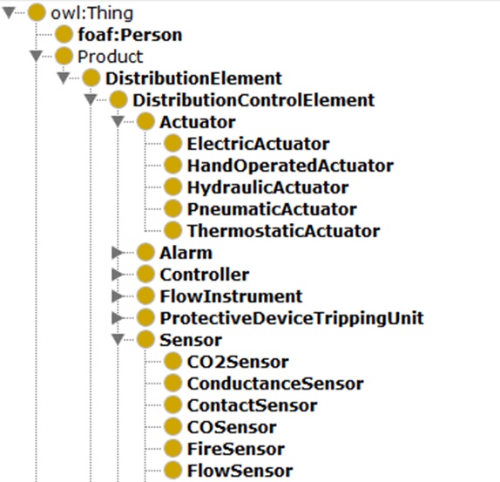
BuildingElement Ontology: product taxonomy
http://pi.pauwel.be/voc/buildingelement#
http://pi.pauwel.be/voc/distributionelement#

Slide 60
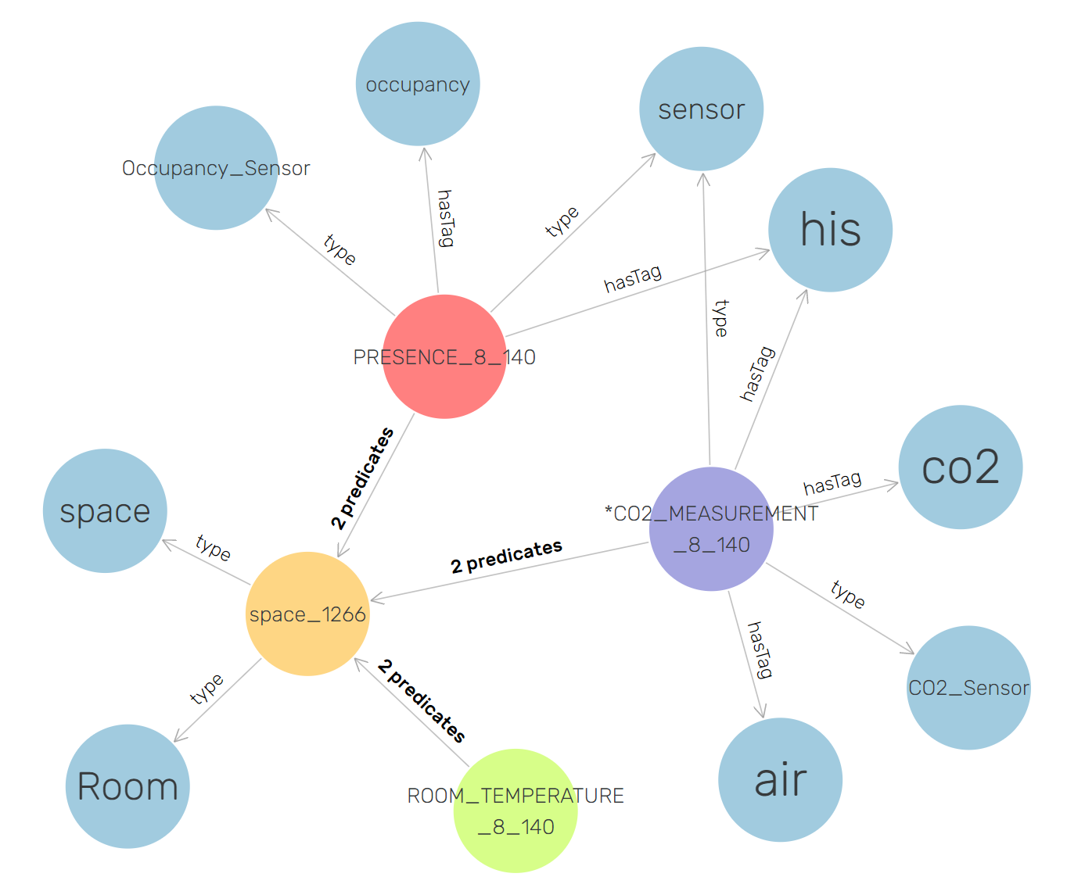
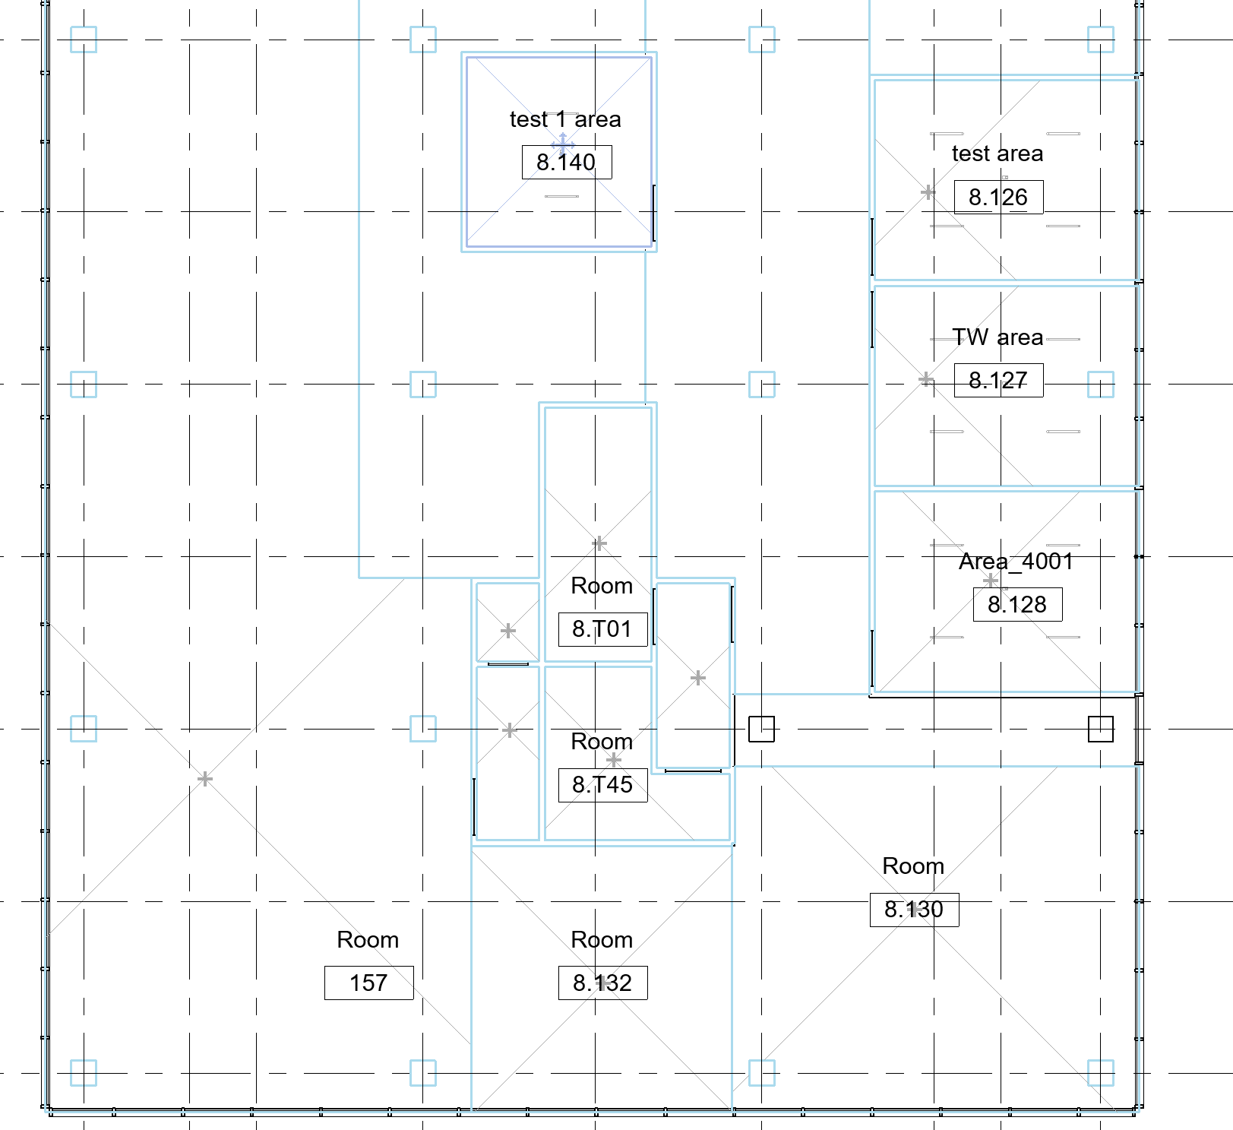
Semantic graph with sensors and building topology

Slide 61
Reference ontologies
BOT https://w3id.org/bot#
BEO https://pi.pauwel.be/voc/buildingelement/
MEP https://pi.pauwel.be/voc/distributionelement/
OMG https://w3id.org/omg#
FOG https://w3id.org/fog#
BPO https://www.w3id.org/bpo#
OPM https://www.w3id.org/opm#
Revit to LBD exporter: on demand
IFC to LBD converter: on demand

Slide 62
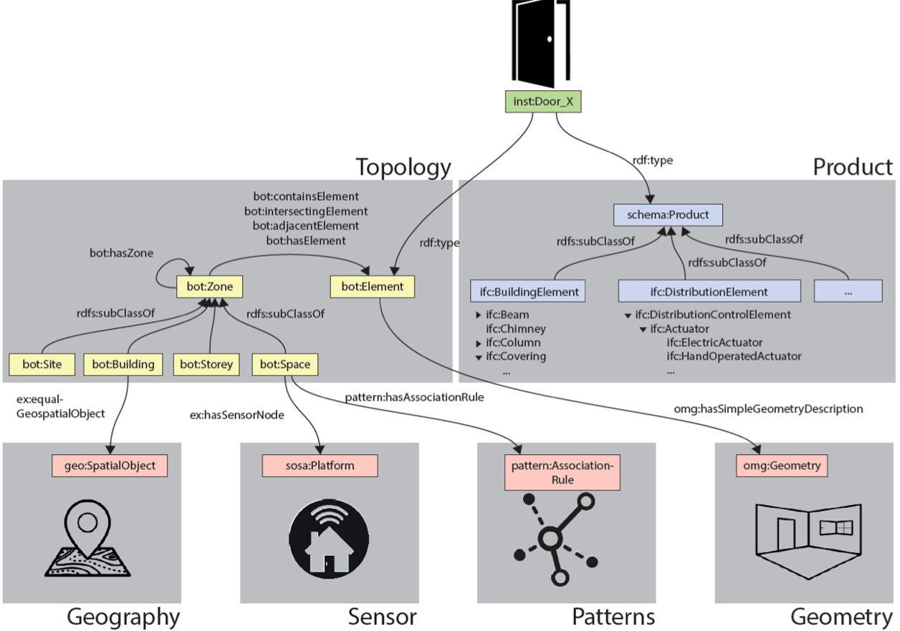

Slide 63
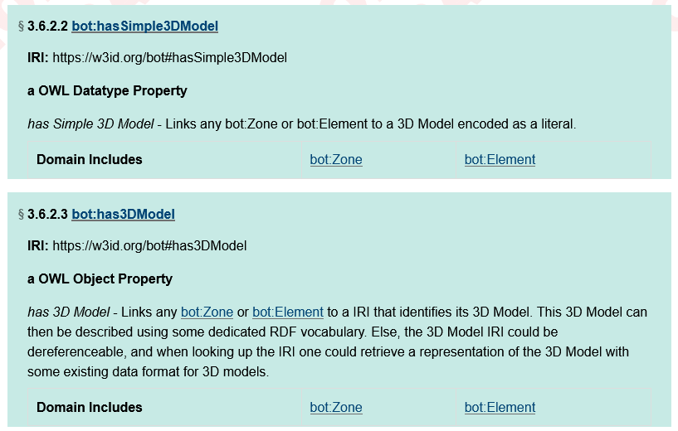
“Hybrid” Knowledge graphs
Heterogeneity! (“Does everything need to be RDF now?”)
How can we link geometry, images, point clouds…?
Direct linking
Multi-models in AEC
ICDD (ISO 21597)
inst:space1 bot:hasSimple3DModel
“v 0 0 0
v 0 6500 0
v 0 6500 2750
n 0 0 1
f 1//1 2//1 3//1”

Slide 64
“Hybrid” Knowledge graphs
Heterogeneity! (“Does everything need to be RDF now?”)
How can we link geometry, images, point clouds…?
Direct linking
Multi-models in AEC
ICDD (ISO 21597)
inst:space1 bot:has3DModel <http://example.org/model1.gltf> .

Slide 65
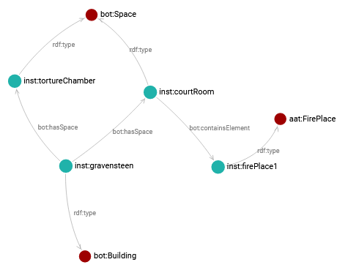
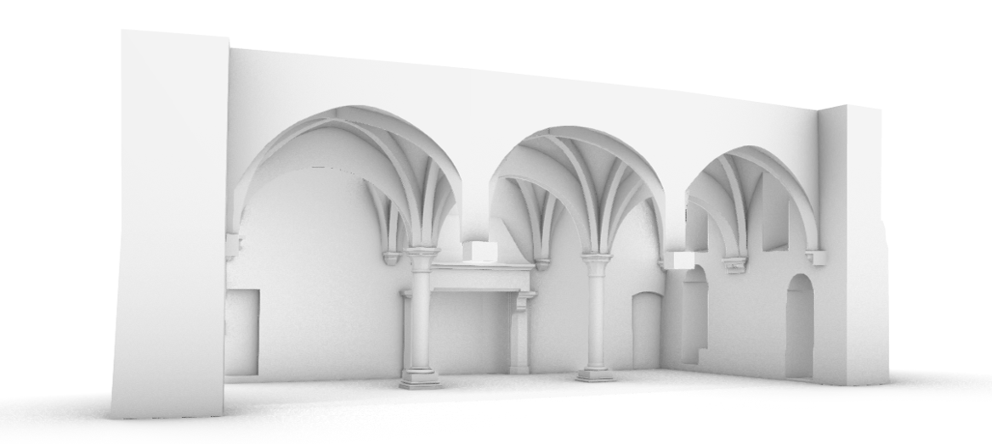
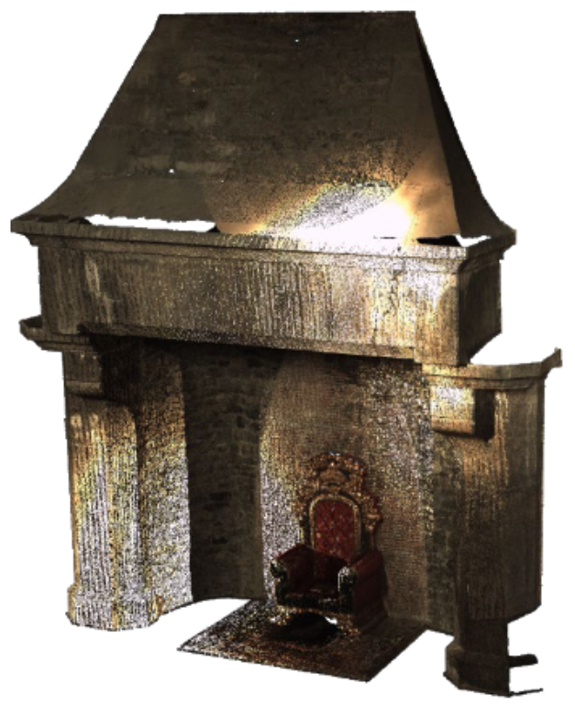
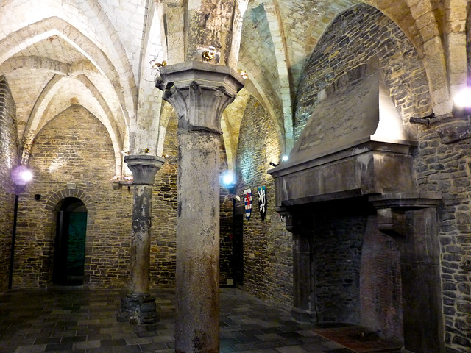
Multi-models: ICDD
(ZIP) CONTAINER
(ISO 21597 – ICDD)
Heterogeneous containers
index.rdf describes the resources/documents
links.rdf describes the relationships between sub-document identifiers
LINKSET

Slide 66


THANK YOU!
Jeroen Werbrouck
Ghent University
RWTH Aachen University
jeroen.werbrouck@ugent.be

